Slide 1
Replication of Automatic Detection of Fake News
Replication Author: Lloyd Shatkin
Original Authors: Verónica Pérez-Rosas, Bennet Kleinberg, Alexandra Lefevre, Rada Mihalcea

Slide 2
Quick Overview
Detecting Fake News using SVM model
Novel Datasets created by the original authors

Slide 3
Replicating Feature Sets
Ngrams
No threshold discussed in paper
Punctuation
Used LIWC data, straightforward
Psycholinguistic Features
Stated 80 out of 95 total features used
Readability
Stated 26 out of 42 total features used
Syntax
Generally ambiguous, required correspondence and further research

Slide 4
Results Overview
Will discuss results from:
FakeNewsAMT Classification
Training Data Increments
Cross-Domain Analysis

Slide 5
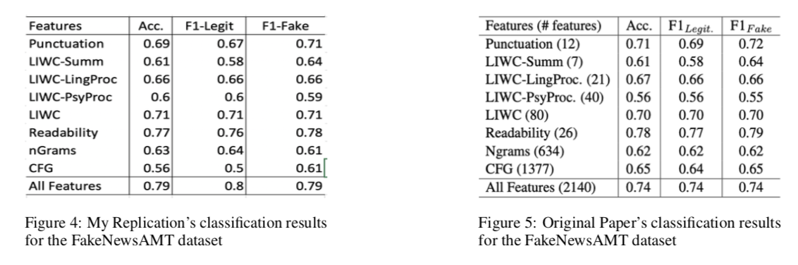
FakeNewsAMT Classification

Slide 6
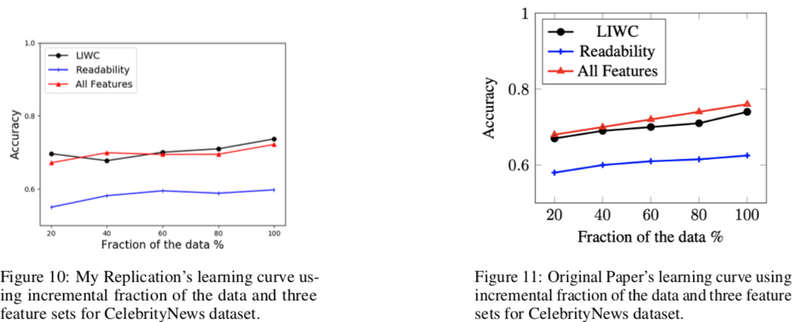
Training Data Increments

Slide 7
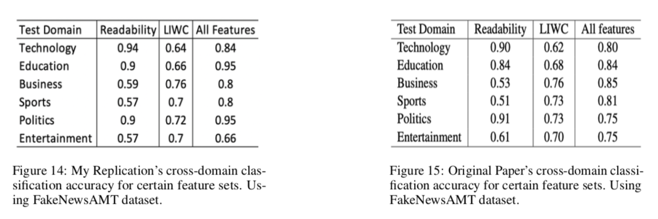
Cross Domain Analysis

Slide 8
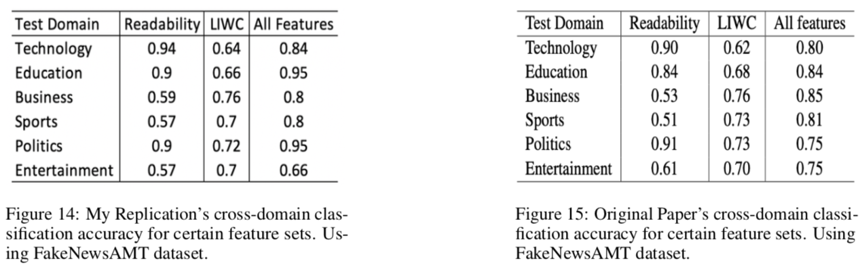
Discussion on Differences
Felt confident when I successfully replicated most – but not all - results
Lack of variance description in original paper made comparison difficult at times
Uncertain about the action necessary when my results exceeded original results

Slide 9
Conclusions
Difficulty lies in small implementation details that are (apparently) not worth mentioning in paper but have huge replication implications
Tf-idf threshold
Stratified Sampling of incremental training data
Difficult to interpret difference in results
Do I think my result came from an implementation error or do I trust my answer?
Different from homework assignments, as no “true” result really exists

